Slide 1

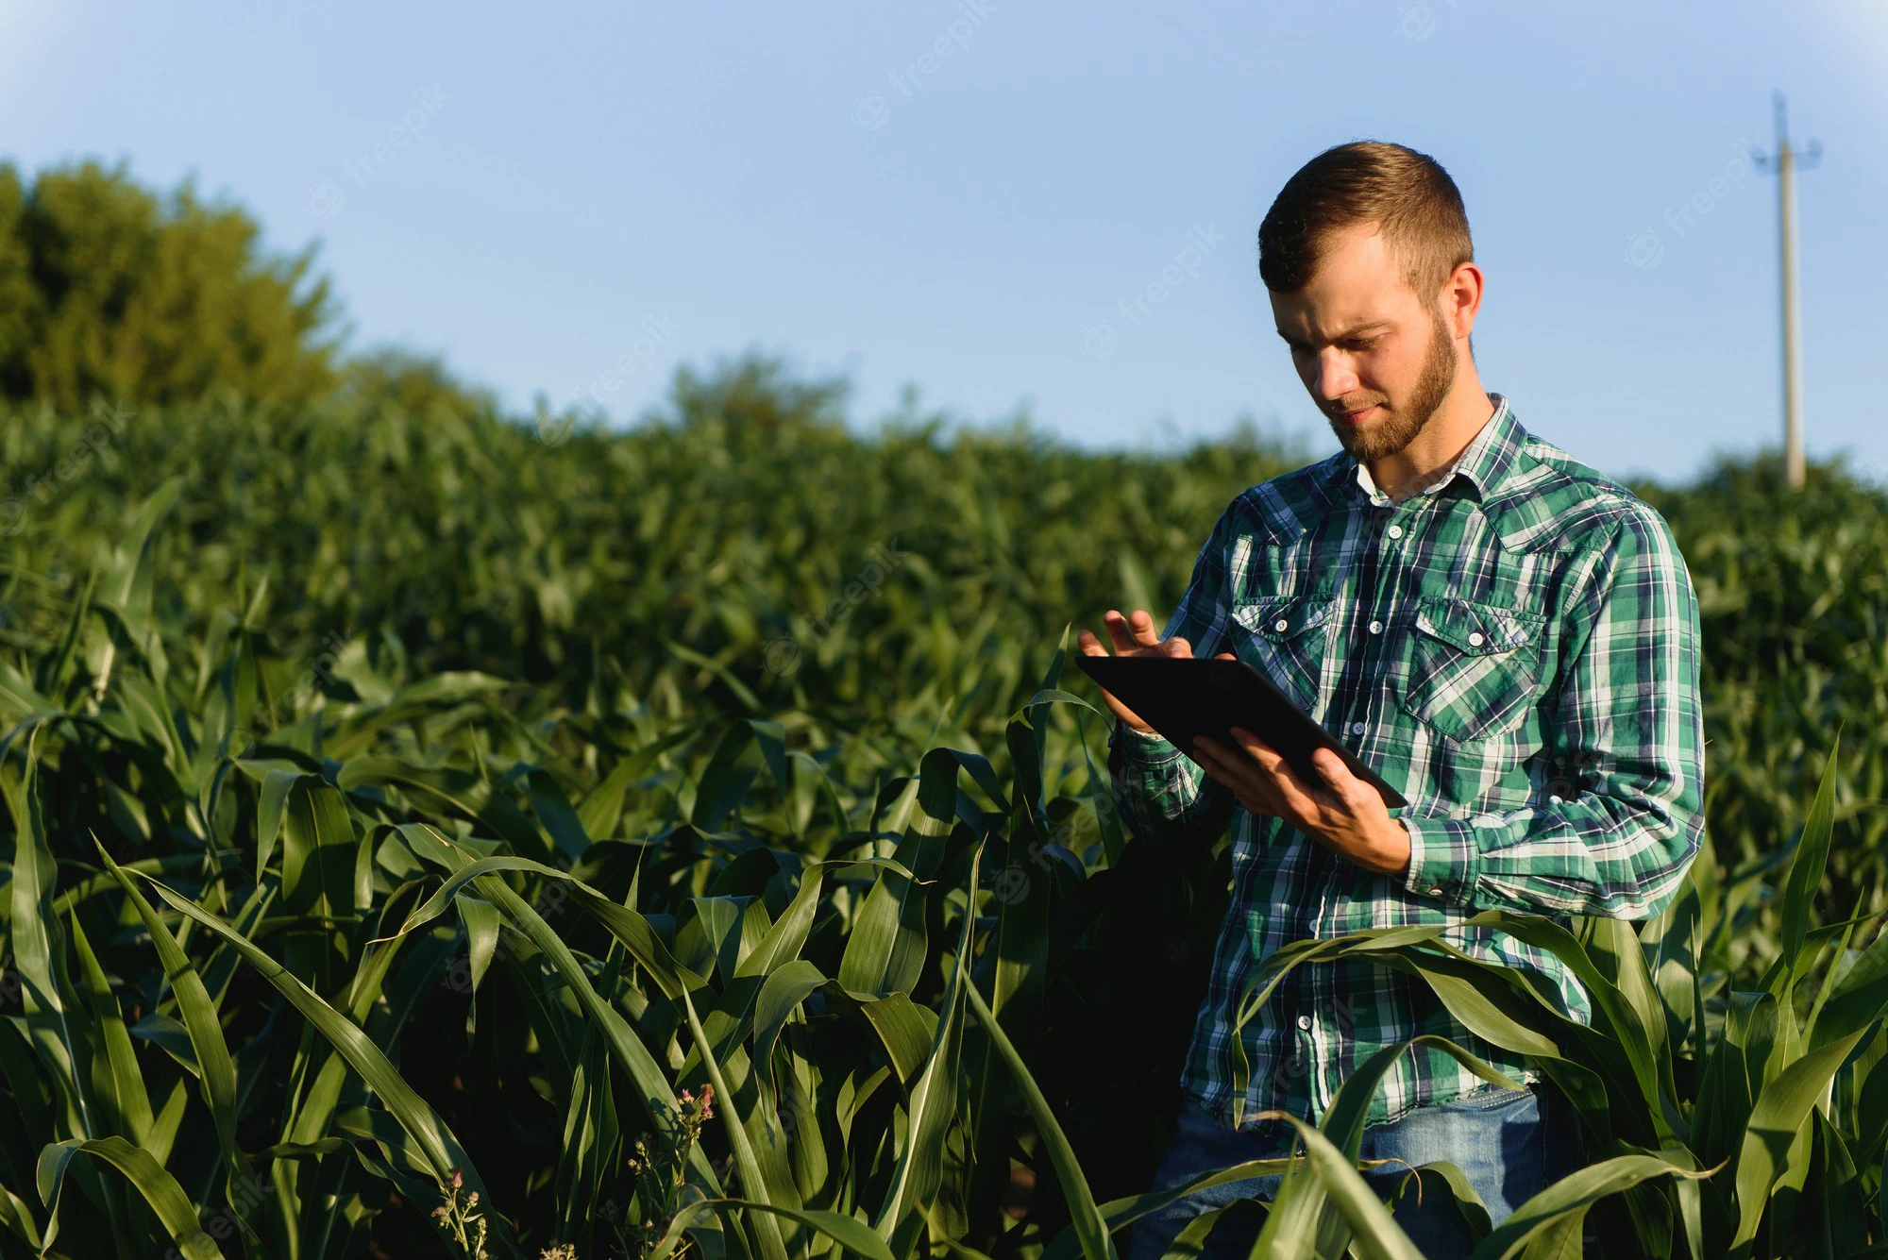
BE-PROJECT
Crop Pattern Recommendation
Team:
Mandar Kulkarni - COMPBEA1109
Atharva Mohite - COMPBEA1104
Ashish Dongare - COMPBEA1103
Prajwal Sable - COMPBEA1102
Guide : Mrs. Vaishali Kolhe
Co Guide : Mrs. P. S. Bhondve

Slide 2
Introduction
Agriculture is an integral part of smart growth. The ability to feed one's own population is critical to the independence of any state. The ability to feed the local population from local sources should not be underestimated. Perhaps because of its long-term presence in the study area, agriculture tends to be taken for granted. Many people expect that it will continue in perpetuity and that as it is pushed out of one area by urban expansion, it will relocate in another area that is less subject to growth pressure. This assumption is false.
Agriculture is a diverse industry with very specific locational connections. Certain crops can only be grown in specific locations where the combination of a variety of factors including soil, moisture, temperature, and topography is right. When such areas are lost to agriculture, the ability to produce the crops that require that particular combination of factors is also lost. The public needs to understand that agricultural land is a nonrenewable resource requiring appropriate management techniques. Before allowing land to go out of production, decision makers must consider the implications of that decision and evaluate it .

Slide 3
Factors
Physical factors
soil
Relief
climate
Socio-economic
factors
market
Transport
Scale of operations
Capital
Government
labour
Tenure

Slide 4
Problem statement
The farmer face the issue of lesser crop yield, due to improper crop pattern, less resources and many of such factors.
The goal here is to solve this problem, by creating platform where user (in this case farmer) can sign in ,get proper analysis reports for his land/crop .Also, along with that platform focuses on developing common communication medium of farmers,investors,retailers market and government, which will centralize the agriculture department.

Slide 5
Motivation
As in India, farming is one of the primary occupation of most of population still we lack in the profits/economy when it comes to farming. The lack of knowledge, resources and poor policies deplete the crop yields ,subsequently leading farmers to take harsh decisions.
Also, almost everyone from team comes from farmers background and have faced/seen similar issues. Hence, it seemed the perfect opportunity as software engineers to deliver a product which can help farmers to boost their crop yield ,providing them right market, acquainting with better policies /schemes thereby help them doing agriculture is more resourceful way

Slide 6
Proposed System
Business case: The final aim is to create a GUI for users(farmers) where user can signup and get statistics ,recommendations on crop as well as communicate with market .
Project deliverables: create a web based application for mobile and desktop users which include 1. recommendation feature ,connect to market feature also the profit tracker for each account.
Constraints: limited data for learning and transactions due to IAM issues .
Exclusions: as mentioned in the constraints ,it wont be including transaction feature.

Slide 7
Literature Survey
Sr. No. | Papers | Topic Reviewed/ Algorithms or methodology used
1 | A Comparative Analysis of Machine Learning Prediction Techniques for Crop Yield Prediction in India A.P.S Manideep, Dr. Seema Kharb | This paper presents a machine learning framework for crop yield prediction using crop and weather data. It also compares the performance of potential machine learning methods like regression, decision trees, random forest, support vector machine and gradient boosting to forecast the yield of 80 crops in India for the year 2001 to 2016 using historical data
2 | Crop yield prediction using machine learning: A systematic literature review Thomas van Klompenburga , Ayalew Kassahuna , Cagatay Catalb | Carefully, analyzed the methods and features used, and provided suggestions for further research. According to analysis, the most used features are temperature, rainfall, and soil type, and the most applied algorithm is Artificial Neural Networks in these models

Slide 8
Sr. No. | Papers | Topic Reviewed/ Algorithms or methodology used
3 | Farmer-to-Consumer Direct Marketing: The Role of Customer Satisfaction Measurement for Service Innovations Achim Spiller,Achim Spiller | This paper analyses the impact of customer satisfaction and its driving forces for farmer-to-consumer direct marketing and is based on a customer survey in 33 organic and conventional on-farm stores in Germany. The results emphasise the role of store atmosphere and customer service as the main influencing factors on customer satisfaction
4 | “A Web System for Farming Management”,Glaubos Climaco, Fernando Chagas, Valéria M. Silva, Gentil V. Barbosa, and Patrick Letouze | This paper presents a web system for farming management that implements a conceptual framework for modeling the production system at a farm scale. The web system supports the design of the production system, which is logically split in three parts: the decision supports sub-system the technical sub-system, and the bio-physical sub-system. Additionally, the web system was designed using interdisciplinary research project management (IRPM) concepts. compensation schemes

Slide 9
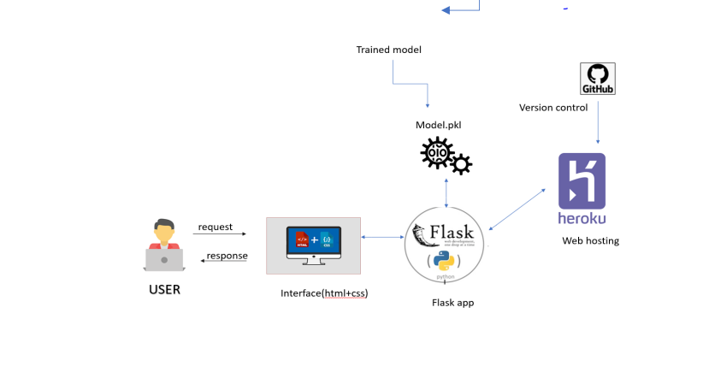
System Architecture
1.Reccomendation module
FLASK API

Slide 10
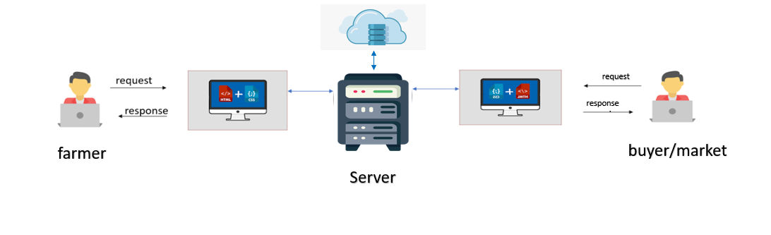
System Architecture
2.Market Module

Slide 11
Algorithms
ASSOCIATION
CLASSIFICATION
SIMILARITY
Yet to finalize

Slide 12
END THANK YOU !

